Slide 1
SPHERICAL TRIGONOMETRY

Slide 2
DEFINITION OF TERMS:
  Spherical Trigonometry – is a branch of trigonometry that concerns with triangles extracted from the surface of the sphere.
  Great Circle – is a circle obtained by passing a section through the center of the sphere.
  Spherical Triangle – is a spherical surface bounded by the area of three great circles.
  Right Spherical Triangle – is a spherical triangle having a right angle.

Slide 3
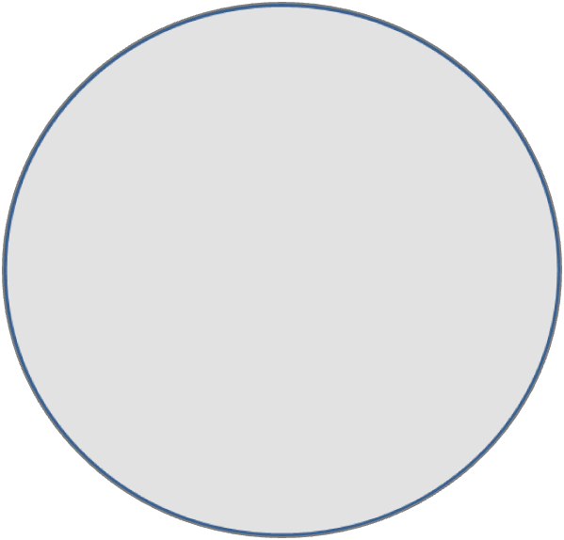
SPHERICAL TRIANGLE
A spherical triangle is that part of the surface of a sphere bounded by three arcs of great circles. The bounding arcs are called the sides of the spherical triangle and the intersection of these arcs are called the vertices. The angle formed by two intersecting arcs is called a spherical angle.
C
A
A
b
B
O
c
C
O
a
B

Slide 4
Important Propositions from Solid Geometry
If two sides are equal, the angles opposite are equal and conversely.
If two sides are unequal , the angles opposite are unequal and the greater side is opposite the greater angle and conversely.
The sum of any two sides is greater than the third side, that is,
a + b > c, a + c > b, b + c > a
The sum of the three sides is less than 360⁰, that is,
0⁰ < a + b + c < 360⁰
The sum of any two angles is less than 180⁰ plus the third angle, that is,
A + B < 180⁰ + C, A + C < 180⁰ + B, B + C < 180⁰ + A
The sum of the angles is greater than 180⁰ and less than 540⁰, that is,
180⁰ < A + B + C < 540⁰

Slide 5
RIGHT SPHERICAL TRIANGLE
Napier’s Circle
B
co - B
co - c
a
c
a
co - A
b
C
A
Where:
co – A = complement of A
co – B = complement of B
co – c = complement of c
b

Slide 6
NAPIER’S RULE
NR1: The sine of any middle part is equal to the product of the tangents of the adjacent parts.
NR2: The sine of any middle part is equal to the product of the cosines of the opposite parts.
Laws of Quadrants
LQ1: Any side and its opposite angle lie in the same quadrant and conversely.
LQ2: (a) If any two sides lie in the same quadrant, then the third side is less than 90⁰ and conversely.
(b) If any two sides lie in different quadrants, then the third side is greater than 90⁰ and conversely.

Slide 7
FUNDAMENTAL FORMULAS:
tan a = tan c cos B
tan a = sin b tan A
tan b = sin a tan B
tan b = tan c cos A
cos c = cot A cot B
sin a = sin c sin A
sin b = sin c sin B
cos c = cos a cos b
cos A = cos a sin B
cos B = cos b sin A

Slide 8
EXAMPLE:
Solve the following right spherical triangle: (C = 90⁰)
a = 50⁰20’ c = 80⁰30’
a = 45⁰57’ b = 68⁰27’
B = 52⁰37’ b = 48⁰20’
B = 48⁰25’ b = 52⁰17’
a = 98⁰52’ A = 38⁰14’

Slide 9
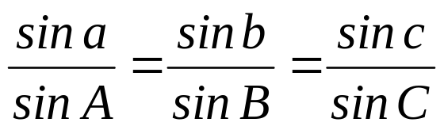
OBLIQUE SPHERICAL TRIANGLE
LAW OF SINES:
LAW OF COSINES: ( for the sides )
cos a = cos b cos c + sin b sin c cos A
cos b = cos a cos c + sin a sin c cos B
cos c = cos a cos b + sin a sin b cos C
LAW OF COSINES: ( for the angles )
cos A = - cos B cos C + sin B sin C cos a
cos B = - cos A cos C + sin A sin C cos b
cos C = - cos A cos B + sin A sin B cos c

Slide 10
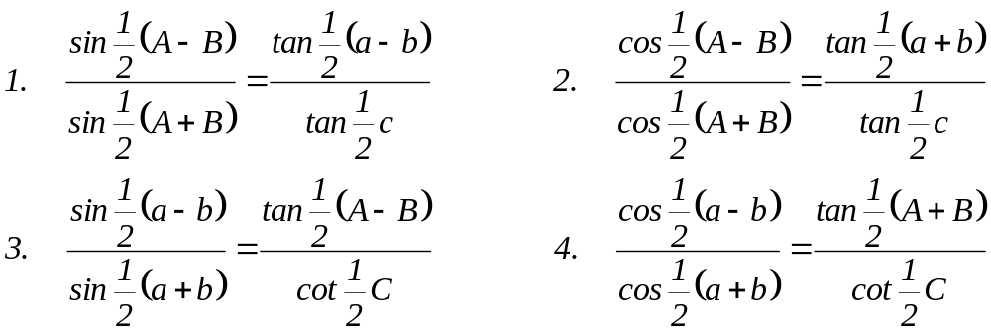
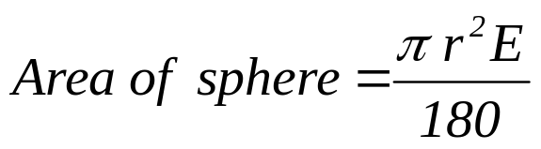
NAPIER’S ANALOGIES:
TERRESTRIAL SPHERE:
where: E = spherical excess in degrees
E = ( A+B+C) - 180

Slide 11
Solution of oblique spherical triangle involves six cases, namely:
Case 1: Two sides and included angle are given.
Case 2: Two angles and the included side.
Case 3: Two sides and an angle opposite one of them.
Case 4: Two angles and a side opposite one of them.
Case 5: Three sides are given.
Case 6: Three angles are given.

Slide 12
EXAMPLE:
Solve the following triangles.
a = 75⁰ b = 110⁰ C = 72⁰
c = 113⁰ B = 66⁰ A = 110⁰
a = 54⁰ b = 25⁰ A = 101⁰
a = 25⁰ B = 108⁰ A = 59⁰
a = 51⁰ b = 81⁰ c = 115⁰
A = 58⁰ B = 143⁰ C = 25⁰

